Slide 1
Disaster Preparedness Planning

Slide 2
There are four elements of Disaster Management
1. Prevention: Before Disaster
2. Preparation: Before disaster
3. Response: During Disaster
4. Recovery: After Disaster

Slide 3
Prevention
Review the history of disasters in your museum/community.
Examples in Savannah: flooding, power outages, hurricanes, tornados
Identify all risks to your building and collection.
Examples at JGLB: Ramps coming into the building, loose shingles, poorly maintained windows. Tasks:
Create a plan to reduce or remove risks.
Incorporate preventive actions into the maintenance and housekeeping schedule.

Slide 4
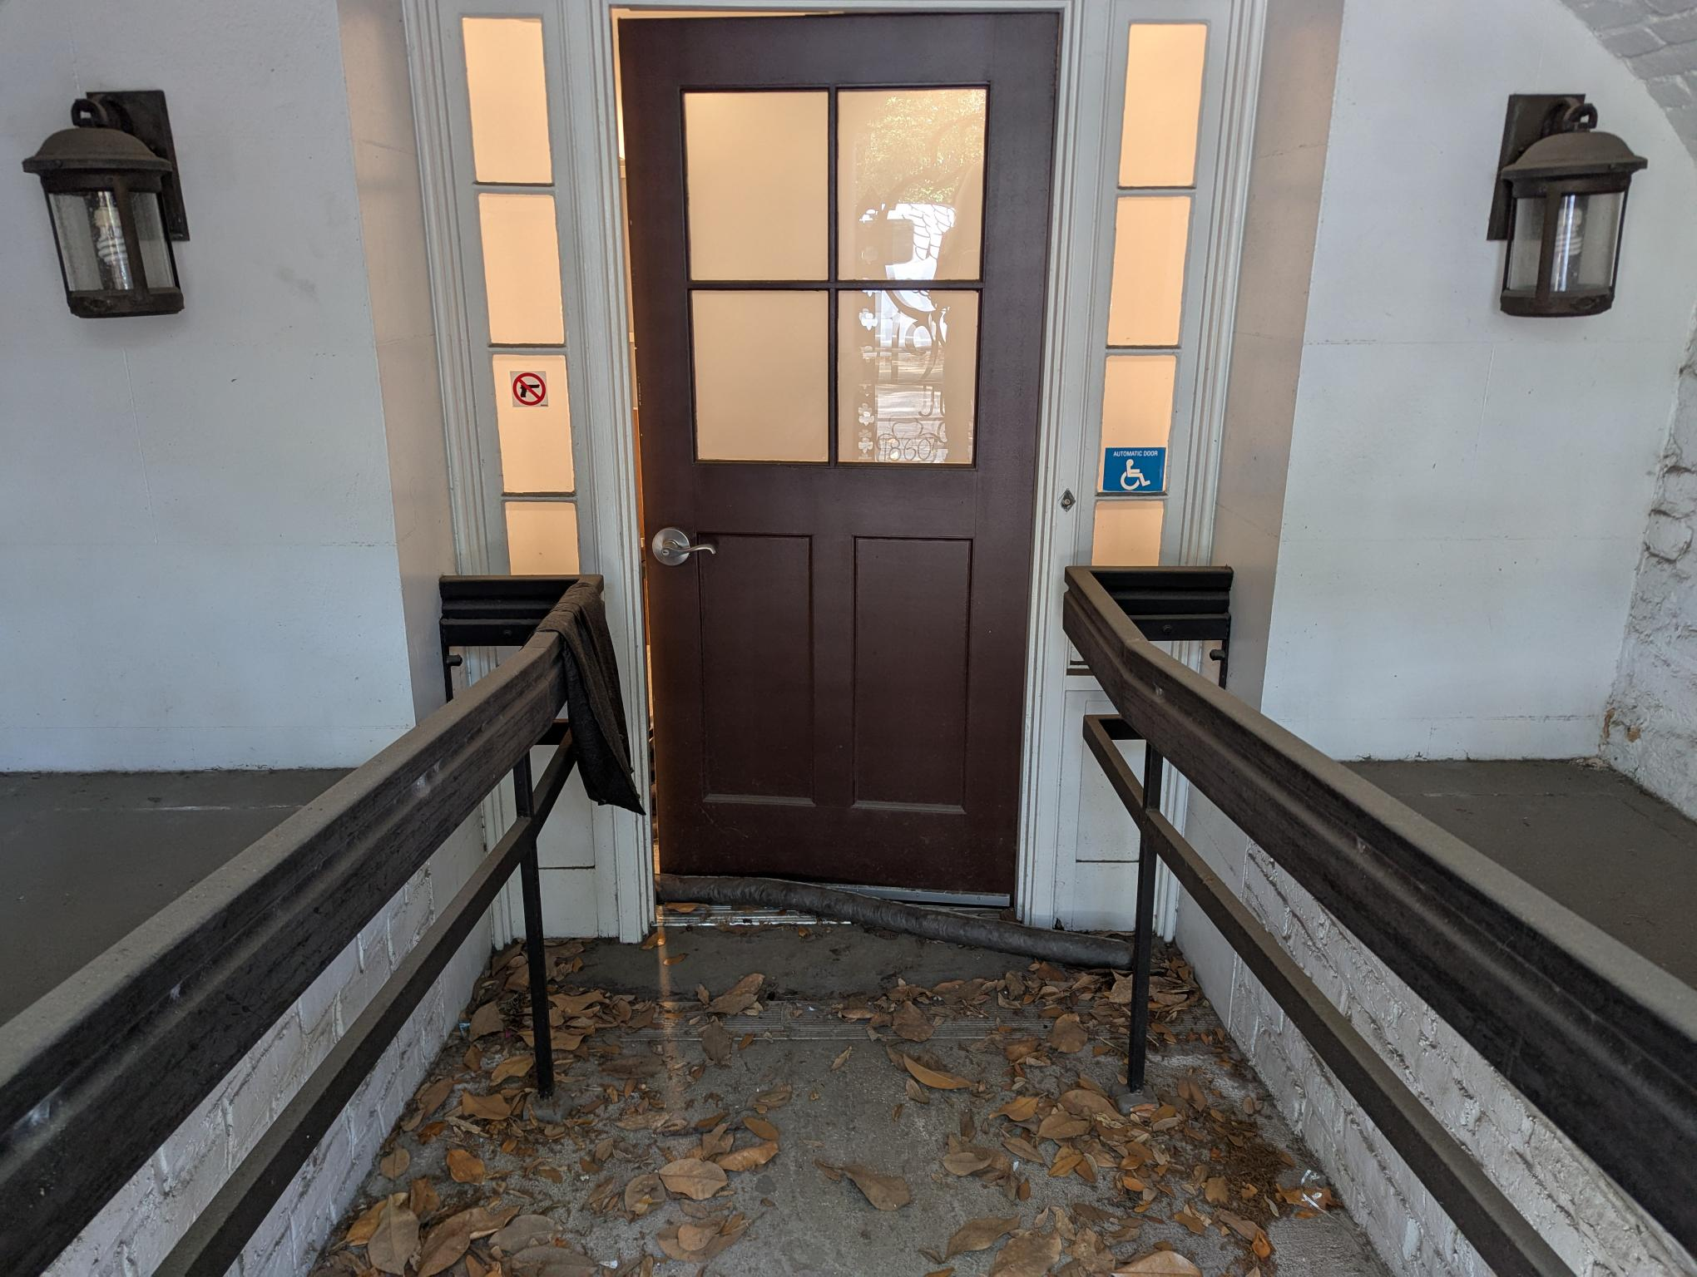
Insert ramp with gutter
Make sure that the drains are clear to prevent flooding.

Slide 5
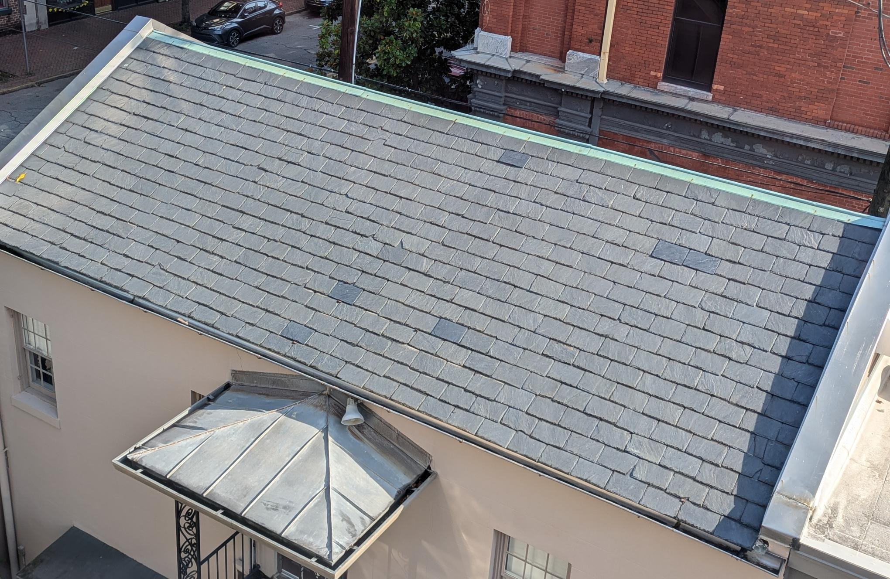
Secure loose shingles before they become a problem.

Slide 6
Preparation
Train your staff.
We have a quick disaster guide for the staff.
Write a priority list for the entire collection that includes location, materials, and highest risks.
This type of list would been needed for recovery and assist you in making decisions if a storm is headed your way.
Digitize your inventory.
If your inventory is not stored in the cloud, it should be digitized somehow.
Create a supply list and gather those supplies.
I would keep these in a labeled bin.

Slide 7
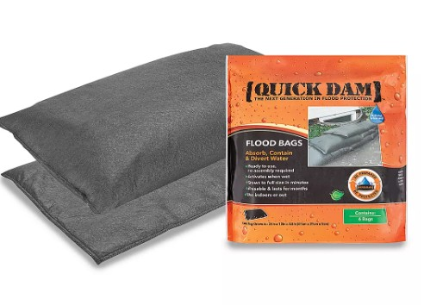
1.1 Inventory of Preparation Supplies on Hand
The following list provides examples of the types of materials that should be on hand in case of an emergency. A staff member should be assigned the responsibility of conducting an inventory of resources on a regular basis.
ITEM
Sandbags or dry bags
Plastic sheeting
Nitrile gloves
Scissors
Packing tape

Slide 8
RESPONSE
These are the things that should be in your Disaster Preparedness and Response Plan:
Emergency procedures to follow.
Evacuation plans for museum staff and visitors.
Strategies for protecting and restoring collections objects.
Documentation on your internal responses teams roles and responsibilities.
Telephone Tree (how to call and in what order)
Floor plans (marking exists, extinguishers, and areas of refuge)

Slide 9
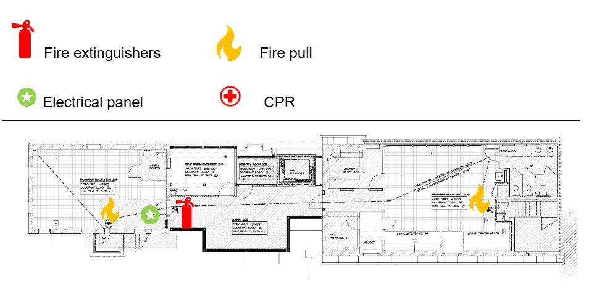

Slide 10
Recovery
You have done all you can do, and disasters will still occur.
The preparation will help make this recovery go smoother.
If at any point of the recovery step you do not feel safe, stop and reach out for help.
You are more important than any collection item.

Slide 11
Assessment of Damage
First assess if your space is safe to walk through.
If it is, in teams of at least two, walk around and take pictures of the damage.
Do not spend more than thirty minutes doing an initial assessment.
Create a document to record the type of damage, cause of damage, and the location of damaged items.

Slide 12
Salvage Options
Once you see the damage and the items affected, you have a few options for salvaging.
Discard
Treat on your own
Send to Conservator

Slide 13
Salvage Options- Discard
If there is an item that is extremely damaged, it may be more expensive to try and salvage than getting a new one.
Uniforms, badges, and handbooks may not be worth trying to salvage, because another copy may be easy to find.
Newspapers are extremely difficult to salvage and often a digital copy is already available.

Slide 14
Salvage Options- Treat on Your Own
If there are items with minimal damage and you feel comfortable, you can treat them on your own.
Water damage is going to be the easiest to do in house.
Paper and Photographs can air dry by lying flat on absorbent fabric and using blotting materials to get excess water out.
You will need to wear protective equipment if you choose to treat anything on your own.
N95 masks
Disposable gloves
Cover your clothing
Remember you are more important that the collection, so do not do anything you are uncomfortable or feel unsafe doing.

Slide 15
Salvage Options- Conservation
If an item is worth salvaging, but you are unsure how to move forward, reach out to a professional.
BMS Cat, Belfor, and Polygon are examples of conservation vendors.
To find a conservator near you that matches your need check Culturalheritage.org.
The National Heritage Responders website also has tips and resources to find a conservator.
https://www.culturalheritage.org/resources/emergencies/national-heritage-responders

Slide 16
Q & A

